Slide 1





Predicting
FLIGHT DELAYS
W261 Final Project In Class Presentation – Group 11 – March 20, 2022
Jeff Adams, Jenny Conde, Dante Malagrino, Joy Moglia, Ram Senthamarai
Notes:
[JENNY]
This is the second week of our product development and this video marks the completion of phase II

Slide 2
OUTLINE
Business Case
Dataset
EDA
Algorithms
Challenges
01
02
Join
2020 & 2021 Data
03
Nulls
Outliers
Trends
04
Models
Pipelines
Crossfold Validation
05
Performance
Scalability
Debugging
Notes:
We’ll provide an update from phase 2 and highlight some challenges we faced during the week.

Slide 3
Predict a 15-min or longer departure delay, given information available 2 hours before the scheduled departure
Flight Delay Prediction as a Binary Classification Problem
Notes:
Our main task this week was obtaining the 2020 and 2021 data and combining all datasets into a single table. We added 10 million new flights.
We had to start completely from scratch on the weather data since we had to use a new source. After some struggles that Ram will discuss more on the next slide, we identified 40 features from 123 columns. We also reduced the weather stations from 12,000 to 710.
We ended up running the full dataset join in 25 minutes.
10 million new flights added to the existing 30 million (~4.6 million in 2020, ~6 million in 2021)
Our main task for this week
We downloaded new data for weather and flights
EDA & Data Cleaning
Airports in 2015-2019 but not in 2020-2021:
ART, CEC, CLD, EFD, ENV, FLO, FNL, IFP, ISN, PGV, TKI, UST, YNG
Airports in 2020-2021 but not in 2015-2019:
ALS, ALW, BIH, CDB, DDC, DEC, EAT, FOD, IPT, JST, MCW, PUW, RIW, SHR, TBN, VCT, YKM
Weather records:
2018 5930277
2015 5941610
2019 5928780
2020 5924023
2016 5961893
2017 5939039
2021 5890056

Slide 4
Business Problem and Metrics
False Positives are more dangerous than False Negatives
A False Negative is not worse than the status quo (unpredictable delay)
(1+β²) · (Precision · Recall)
F_{β} =
(β² · Precision + Recall)
Notes:
Jeff:
Because of challenges in implementing the new dataset, we spent less time than planned on EDA for the full dataset. We began by looking at correlations between delay and weather features, as seen in this correlation matrix. There is a strong correlation between delay time and the presence of hail at the origin airport, which is not surprising. Over the next weeks, we will perform additional EDA to get a better understanding of the data.
Because of challenges in retrieving the data, we haven’t had enough time yet to conduct a full EDA on the dataset
Started looking at correlation between delay and weather features
Early finding shows that xxxx is a good predictor of departure delay
Ex. hail at the origin airport

Slide 5
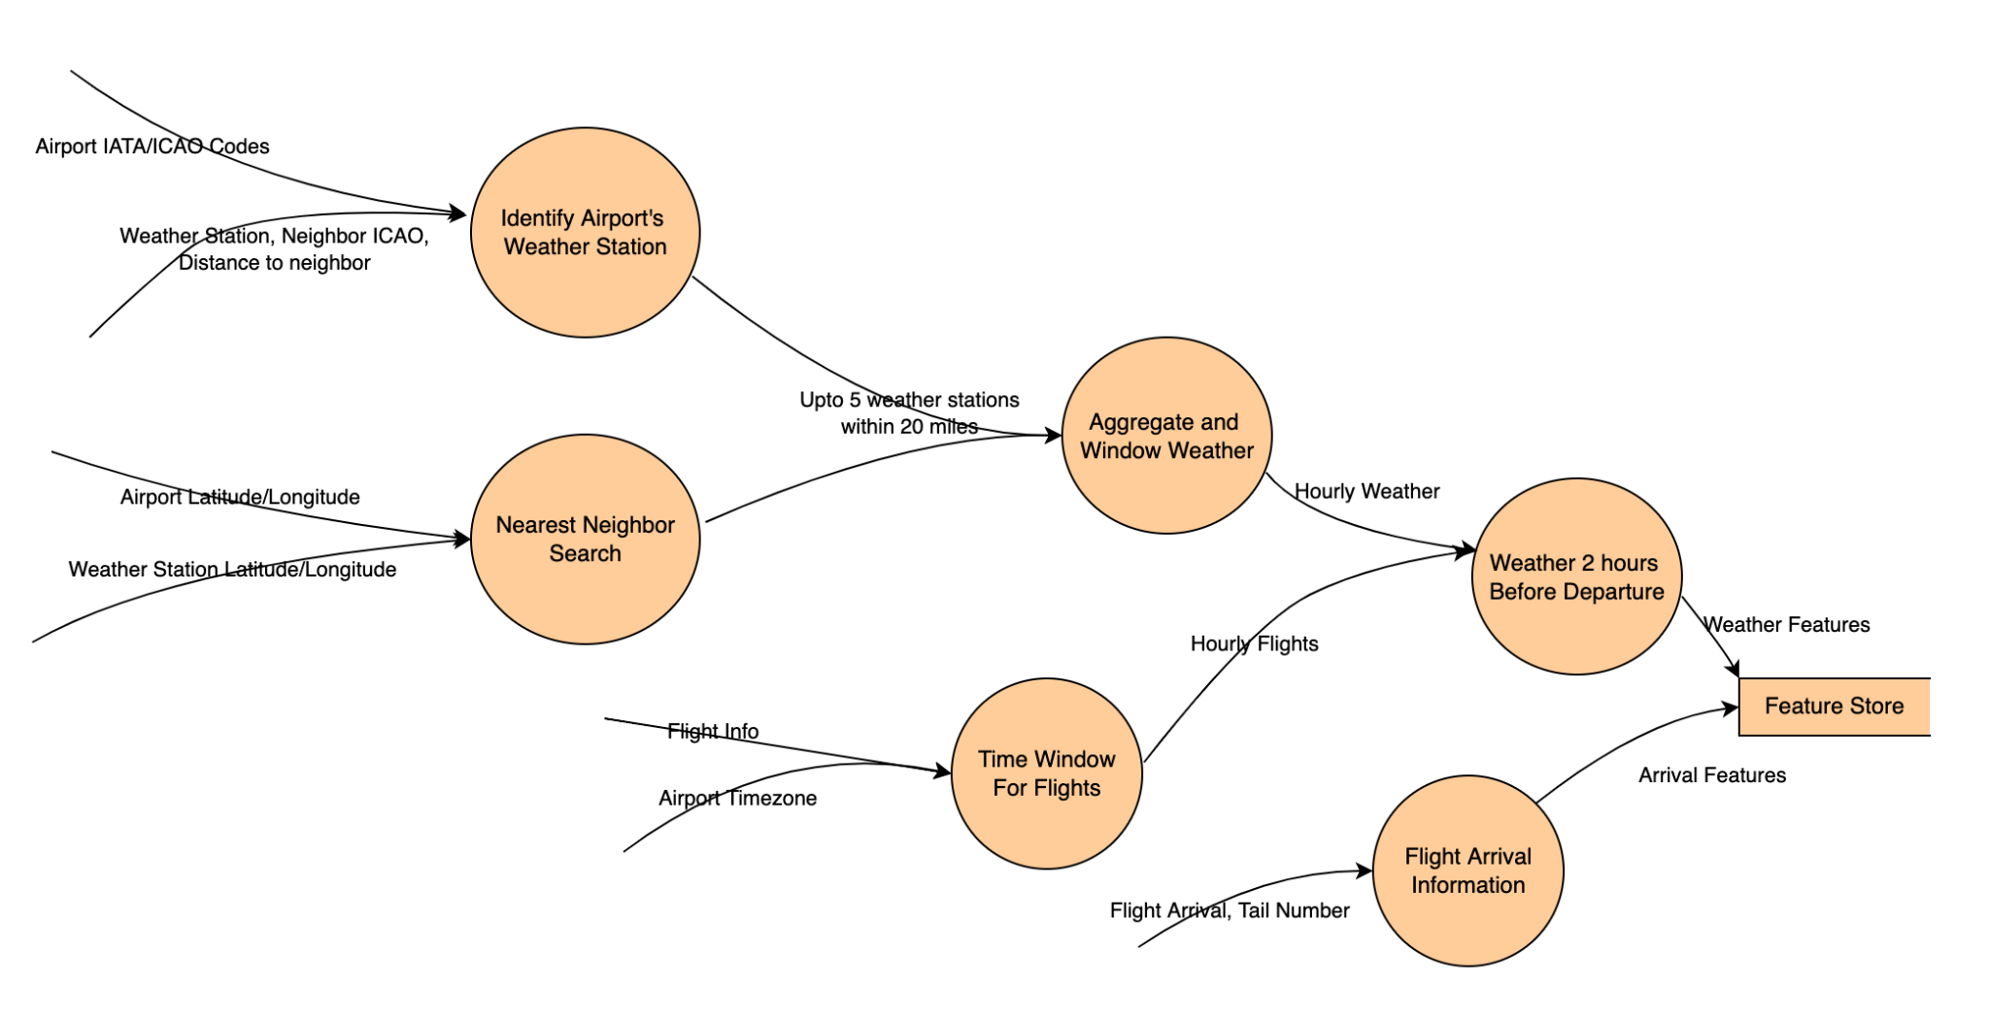
Datasets
Notes:
Dante:
As you heard, we faced some challenges this week, but we accomplished a lot and we think that the addition of 2020 and 2021 data will give us some interesting insights at the end.
For the next phase of the project, our plan is to work with the joined dataset and shift the focus from analysis of the data to model building.
Thank You!

Slide 6
2020 & 2021 DATA
Download
EDA
Clean
Join
EDA
Flights Data
Downloaded monthly CSVs for 2020 and 2021 (from BTS)
10 million new flights
Emergence of smaller, regional airports - will explore more later
Weather Data
2015-2021 data from Local Climatological Data
Derived 40 features from 123 columns
Reduced weather stations (12,000 to 710),
improving join time
11.8 million weather records in 2020 & 2021 - 41 million records total
Full dataset join time under 25 minutes
Notes:
Our main task this week was obtaining the 2020 and 2021 data and combining all datasets into a single table. We added 10 million new flights.
We had to start completely from scratch on the weather data since we had to use a new source. After some struggles that Ram will discuss more on the next slide, we identified 40 features from 123 columns. We also reduced the weather stations from 12,000 to 710.
We ended up running the full dataset join in 25 minutes.
10 million new flights added to the existing 30 million (~4.6 million in 2020, ~6 million in 2021)
Our main task for this week
We downloaded new data for weather and flights
EDA & Data Cleaning
Airports in 2015-2019 but not in 2020-2021:
ART, CEC, CLD, EFD, ENV, FLO, FNL, IFP, ISN, PGV, TKI, UST, YNG
Airports in 2020-2021 but not in 2015-2019:
ALS, ALW, BIH, CDB, DDC, DEC, EAT, FOD, IPT, JST, MCW, PUW, RIW, SHR, TBN, VCT, YKM
Weather records:
2018 5930277
2015 5941610
2019 5928780
2020 5924023
2016 5961893
2017 5939039
2021 5890056

Slide 7
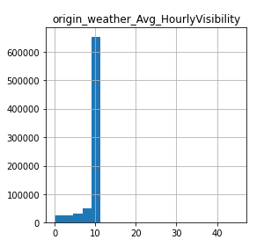
EDA
Nulls (96 Columns)
44 Diversion Columns
Average
Drop
Set to zero
Outliers
Wind speed
Visibility
Precipitation
Column Name | Null Count
DIV4_AIRPORT | 31434425
DIV4_AIRPORT_ID | 31434425
DIV4_AIRPORT_SEQ_ID | 31434425
DIV4_WHEELS_ON | 31434425
DIV4_TOTAL_GTIME | 31434425
DIV4_LONGEST_GTIME | 31434425
DIV4_WHEELS_OFF | 31434425
DIV4_TAIL_NUM | 31434425
Notes:
Jeff:
Because of challenges in implementing the new dataset, we spent less time than planned on EDA for the full dataset. We began by looking at correlations between delay and weather features, as seen in this correlation matrix. There is a strong correlation between delay time and the presence of hail at the origin airport, which is not surprising. Over the next weeks, we will perform additional EDA to get a better understanding of the data.
Because of challenges in retrieving the data, we haven’t had enough time yet to conduct a full EDA on the dataset
Started looking at correlation between delay and weather features
Early finding shows that xxxx is a good predictor of departure delay
Ex. hail at the origin airport

Slide 8
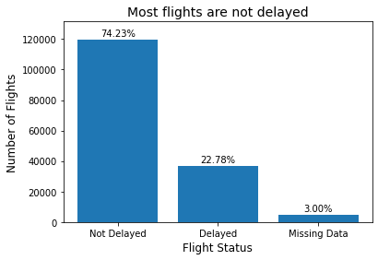
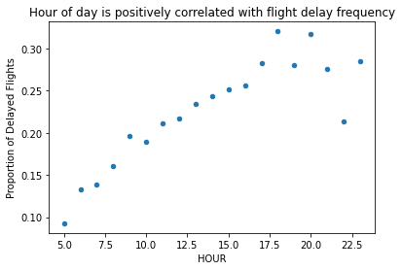
EDA
Notes:
Ram:
We also faced a few challenges. For example, importing and ingesting 450 GB of data was hard. We learned that limiting the amount of data earlier is better. Limiting to weather stations near airports reduced the ingestion time from 5 hours to 17 minutes. Also, Spark’s default 1 MB parquet files were not efficient. Repartitioning the data ensured better file sizes. Finally, Spark’s schema inference did not work for us. So we did explicit data type conversion.
Another challenge was the duration of the join. We grouped both flights and weather data into 1-hour windows and filtered the weather stations, giving us the 25 minutes join time.
However, by doing this, we now suspect data leakage issues which needs further investigation.
Importing about 450 GB of weather data for 7 years and manipulating it was very costly and time consuming, compounded by the inadvertent rookie mistakes. In the process, we learnt that reducing the data work much earlier in the process helps. Limiting the number of weather stations to those near airports of interest even before the ingestion process helped. We reduced the ingestion time from 5 hours to under 25 minutes.
Another challenge we had was that, by default, Spark was creating multiple 1 mb parquet files that lead to large read times. Repartitioning with year as partition key helped.
Spark's data type inference logic gave us a lot of grief. We ended up ingesting all fields as strings and applied our own conversion for the fields we need.
Grouping flights and weather into 24 windows per day (1 for the hour of the day), in addition to the reduced weather stations to look at, helped us achieve join time of about 25 minutes. The logic also includes a simple aggregation of weather data from potentially multiple readings within the hour.
Identifying potential data leakage issues with current hourly weather aggregation method
That was not easy to achieve. We had quite a few challenges. For example, we had to work with 450 GB of data, which presented challenges for importing and ingesting. We had to do a couple of iterations because of rookie mistakes.
The earlier you limit the amount of data you work with, the better.
We removed weather stations early on, which helped us implement the join in 25 minutes.

Slide 9
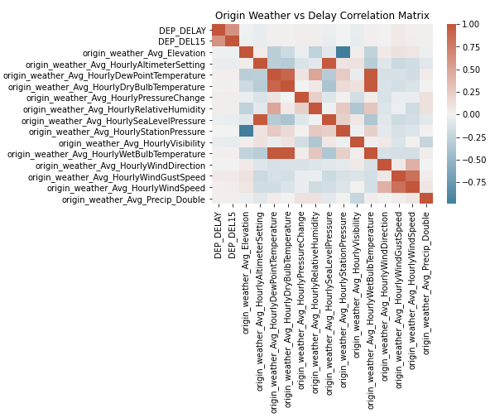
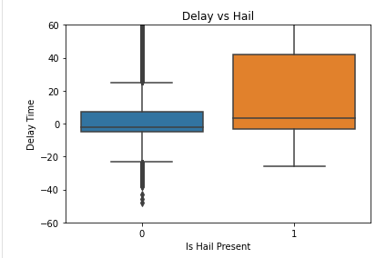
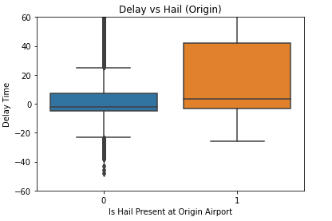
EDA
Notes:
Jeff:
Because of challenges in implementing the new dataset, we spent less time than planned on EDA for the full dataset. We began by looking at correlations between delay and weather features, as seen in this correlation matrix. There is a strong correlation between delay time and the presence of hail at the origin airport, which is not surprising. Over the next weeks, we will perform additional EDA to get a better understanding of the data.
Because of challenges in retrieving the data, we haven’t had enough time yet to conduct a full EDA on the dataset
Started looking at correlation between delay and weather features
Early finding shows that xxxx is a good predictor of departure delay
Ex. hail at the origin airport

Slide 10
Feature Engineering
Holidays
Tail Number
….
Notes:
Jeff:
Because of challenges in implementing the new dataset, we spent less time than planned on EDA for the full dataset. We began by looking at correlations between delay and weather features, as seen in this correlation matrix. There is a strong correlation between delay time and the presence of hail at the origin airport, which is not surprising. Over the next weeks, we will perform additional EDA to get a better understanding of the data.
Because of challenges in retrieving the data, we haven’t had enough time yet to conduct a full EDA on the dataset
Started looking at correlation between delay and weather features
Early finding shows that xxxx is a good predictor of departure delay
Ex. hail at the origin airport

Slide 11
Algorithms
Logistic Regression
Pipeline
Notes:
Jeff:
Because of challenges in implementing the new dataset, we spent less time than planned on EDA for the full dataset. We began by looking at correlations between delay and weather features, as seen in this correlation matrix. There is a strong correlation between delay time and the presence of hail at the origin airport, which is not surprising. Over the next weeks, we will perform additional EDA to get a better understanding of the data.
Because of challenges in retrieving the data, we haven’t had enough time yet to conduct a full EDA on the dataset
Started looking at correlation between delay and weather features
Early finding shows that xxxx is a good predictor of departure delay
Ex. hail at the origin airport

Slide 12
Crossfold Validation
J
F
M
A
M
J
J
A
S
O
N
D
2015
T1
T1
T1
V1
T2
T2
T2
V2
2016
2017
2018
Notes:
Jeff:
Because of challenges in implementing the new dataset, we spent less time than planned on EDA for the full dataset. We began by looking at correlations between delay and weather features, as seen in this correlation matrix. There is a strong correlation between delay time and the presence of hail at the origin airport, which is not surprising. Over the next weeks, we will perform additional EDA to get a better understanding of the data.
Because of challenges in retrieving the data, we haven’t had enough time yet to conduct a full EDA on the dataset
Started looking at correlation between delay and weather features
Early finding shows that xxxx is a good predictor of departure delay
Ex. hail at the origin airport

Slide 13
CHALLENGES
Performance
Scalability
Debugging
Notes:
Ram:
We also faced a few challenges. For example, importing and ingesting 450 GB of data was hard. We learned that limiting the amount of data earlier is better. Limiting to weather stations near airports reduced the ingestion time from 5 hours to 17 minutes. Also, Spark’s default 1 MB parquet files were not efficient. Repartitioning the data ensured better file sizes. Finally, Spark’s schema inference did not work for us. So we did explicit data type conversion.
Another challenge was the duration of the join. We grouped both flights and weather data into 1-hour windows and filtered the weather stations, giving us the 25 minutes join time.
However, by doing this, we now suspect data leakage issues which needs further investigation.
Importing about 450 GB of weather data for 7 years and manipulating it was very costly and time consuming, compounded by the inadvertent rookie mistakes. In the process, we learnt that reducing the data work much earlier in the process helps. Limiting the number of weather stations to those near airports of interest even before the ingestion process helped. We reduced the ingestion time from 5 hours to under 25 minutes.
Another challenge we had was that, by default, Spark was creating multiple 1 mb parquet files that lead to large read times. Repartitioning with year as partition key helped.
Spark's data type inference logic gave us a lot of grief. We ended up ingesting all fields as strings and applied our own conversion for the fields we need.
Grouping flights and weather into 24 windows per day (1 for the hour of the day), in addition to the reduced weather stations to look at, helped us achieve join time of about 25 minutes. The logic also includes a simple aggregation of weather data from potentially multiple readings within the hour.
Identifying potential data leakage issues with current hourly weather aggregation method
That was not easy to achieve. We had quite a few challenges. For example, we had to work with 450 GB of data, which presented challenges for importing and ingesting. We had to do a couple of iterations because of rookie mistakes.
The earlier you limit the amount of data you work with, the better.
We removed weather stations early on, which helped us implement the join in 25 minutes.

Slide 14
CONCLUSIONS
ACCOMPLISHMENTS
NEXT STEPS
Notes:
Dante:
As you heard, we faced some challenges this week, but we accomplished a lot and we think that the addition of 2020 and 2021 data will give us some interesting insights at the end.
For the next phase of the project, our plan is to work with the joined dataset and shift the focus from analysis of the data to model building.
Thank You!

Slide 15
THANK YOU

